Slide 1


Quantum Communications Group
KML - architecture proposal
Group Coordinator:
Armando Nolasco Pinto
anp@ua.pt
Group Websites:
https://www.it.pt/Groups/Index/72
LinkedIn: https://www.linkedin.com/company/quantum-communications-group-it-av/
Diogo Matos

Slide 2
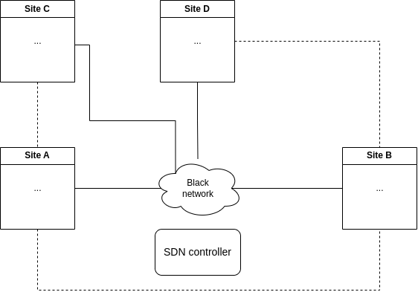
QKD network
Multiple sites with one or more nodes inside them have one or more peers
Network is managed by the SDN controller
Notes:
Apresentar aspeto geral da rede

Slide 3
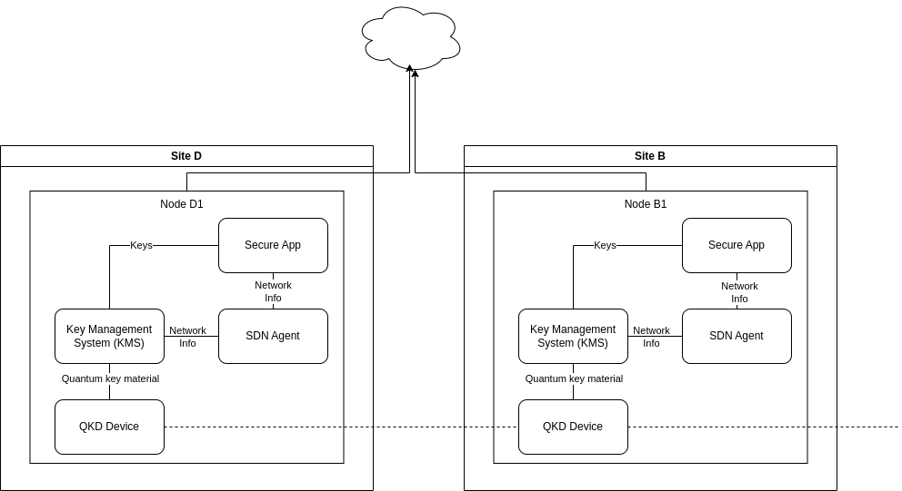
QKD node
Notes:
Apresentar entidades principais.

Slide 4
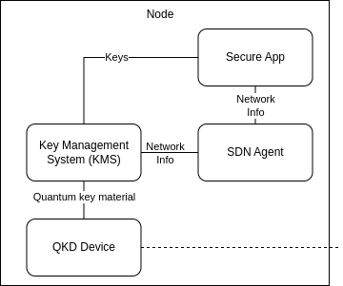
Secure App
Any QKD key based service
Multiple inside the same node
Quantum Genome e.g.
Use KMS in order to retrieve keys

Slide 5
SDN Agent
Connect to the SDN controller
It’s the SDN controller representative inside each node
Is always in communication with KMS in order to keep QoS measures, for routing control and retrieve and provide information concerning the KML

Slide 6
QKD Device
Generates quantum key material in sync with a peer
Provides key material to the KMS through an interface

Slide 7
Key Management System
Receive the symmetric quantum key material generated from a QKD device
Store key material, metadata and other information about its state;
Manage the stored key material;
Derive keys from QKD key material;
Provide keys to the applications;
Relay key material through the QKDN to remote peers;
Interact with SDN;
Authenticate peer KMSs, apps and other directly connected components;
Synchronize with peers;

Slide 8
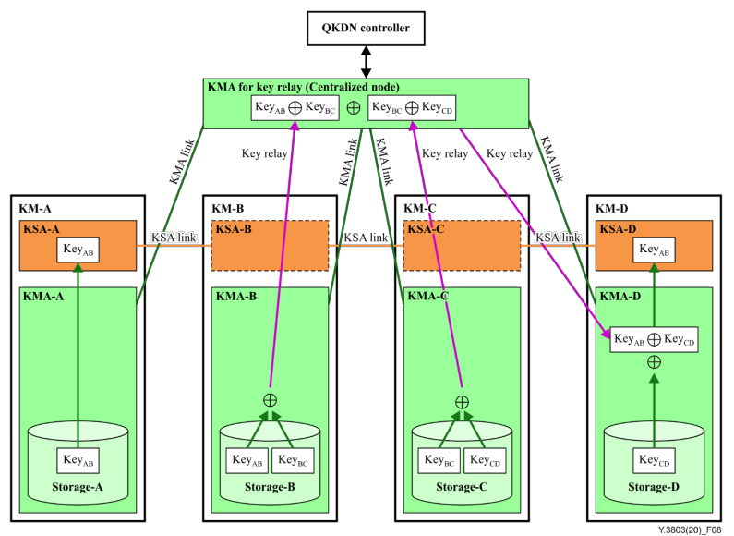
Key relay - centralized node solution
Communication secure by OTP
If done bidirectionally only the two KMSs that want to create a shared key will know the key
Coordination is crucial and needs to be well planned
All nodes rely on the same key relay centralized node, this fact might congest it
Larger network may require multiple key relay centralized nodes.
Notes:
Symmetric keys are required to be present at two arbitrary nodes in the QKDN

Slide 9
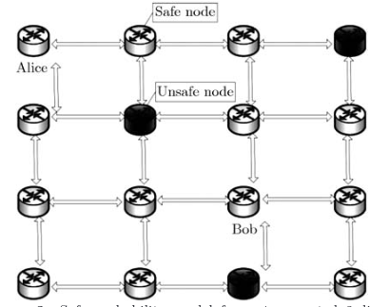
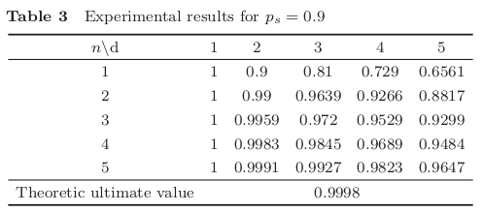
Key relay - stochastic solution
Communication secure by OTP
Increased network’s overall congestion
Use of a routing matrix provided by the SDN controller generated taking into account QoS measures
Security decreases with distance but increases with a higher number of distinct paths
Notes:
explicar processo e resultados (d-distancia, n-numero de diferentes caminhos). matriz de routing cadeia de markov

Slide 10
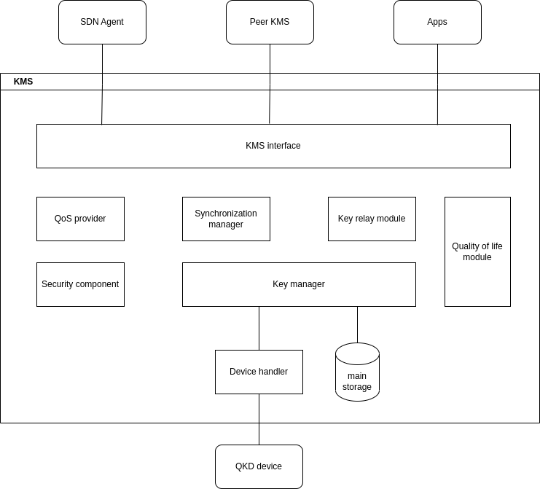
Key Management System Modules
Notes:
QKD North Bound Interface:
ETSI 004 based interface to the applications;
SDN Agent interaction;
Inter KMS communication (for auth, sync and key relay).
QoS provider:
Gathers and calculates all parameters required for QoS information.
Synchronization manager:
Handles the synchronization protocol with the peer KMS;
Since all keys must be in sync with between peers, this module is used in almost all features.
Security module:
Implements all cryptographic algorithms used during operation of the KMS;
This includes the ITS algorithms such as Key combination and Wegman Carter authentication as well as Post Quantum Cryptography algorithms.
Key Forwarding Module:
Handles the key relay process.
Key manager:
Maintains and handles the keys;
Is mainly used for key material retrieval, storage, etc.;
It’s involved in any activity related with keys (almost all).
Base functionality:
Handles several quality-of-life features such as logging and configuration.

Slide 11
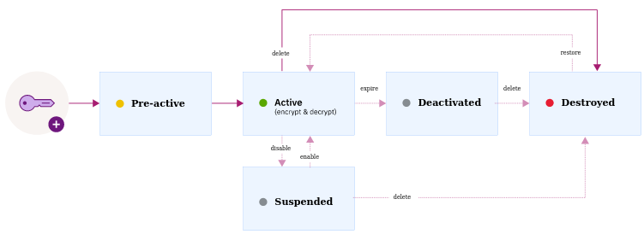
Key storage and key life-cycle
Key material and its metadata is always authenticated before storage
KMS has a database to store different kind of keys or key material. They can be divided into distinct main state groups (pre-active, active, deactive)
Each key or key material has metadata attached to it, such as KSID, state, creation time, identification of the peers, etc.
Notes:
Periodic routines should keep the life-cycle of each key flowing as expected.
Passa para suspended quando a sua validade passa
Passa deactivated uma hora depois de expirar
Ter operações de wrap, unwrap e rotate de chaves.
Possivelmente o rotate será desnecessário caso uma chave só possa ser dada uma única vez e com um curto período de vida.

Slide 12
Key provisioning
Interface based on ETSI GS QKD 004 that specifies an API between the KMS and the applications
Interface QKD (
OPEN_CONNECT (in source, in destination, inout QOS, inout KSID, out status);
GET_KEY (in Key_stream_ID, inout index, out Key_buffer, inout Metadata, out status);
CLOSE (in Key_stream_ID, out status);
)
Notes:
falta fazer relay que irá complicar o processo

Slide 13
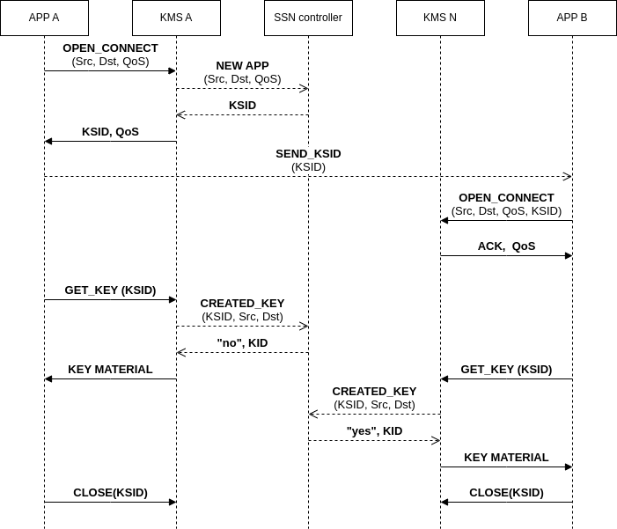

Slide 14
Next steps
Authentication and secure communication
KMS ⇔ KMS
APP ⇔ KMS
KMS ⇔ QKD device
KMS/APP ⇔ SDN agent
SDN agent ⇔ SDN controller
Key relay
method
entities involved
message interchange (including key auth)
KMS synchronization
crucial points of synchronization
message interchange
continuous authentication
SDN controller (& agent) interaction with KMS
QoS requests
KMS information share for system normal functioning
Oblivious keys integration
Notes:
autenticação -
vimos autenticação usando certificados com suporte pos quantico para autenticação e uso de kem com pqa
uso de psk com tls-psk sobre tcp (não uso de criptografia pública e limitações dos PQA)
atualização de psk

